Slide 1
Release angle: understanding offensive and Defensive impacts
Edward Feng, Frank Li
Rice University
March 2020

Slide 2
Motivation
Contested shots have lower FG% than open shots
Current popular metrics (FG%, Off./Def. Rating etc.) reflect the binary result of shots
But what factors lead to the result?
What does “contest” really mean?

Slide 3
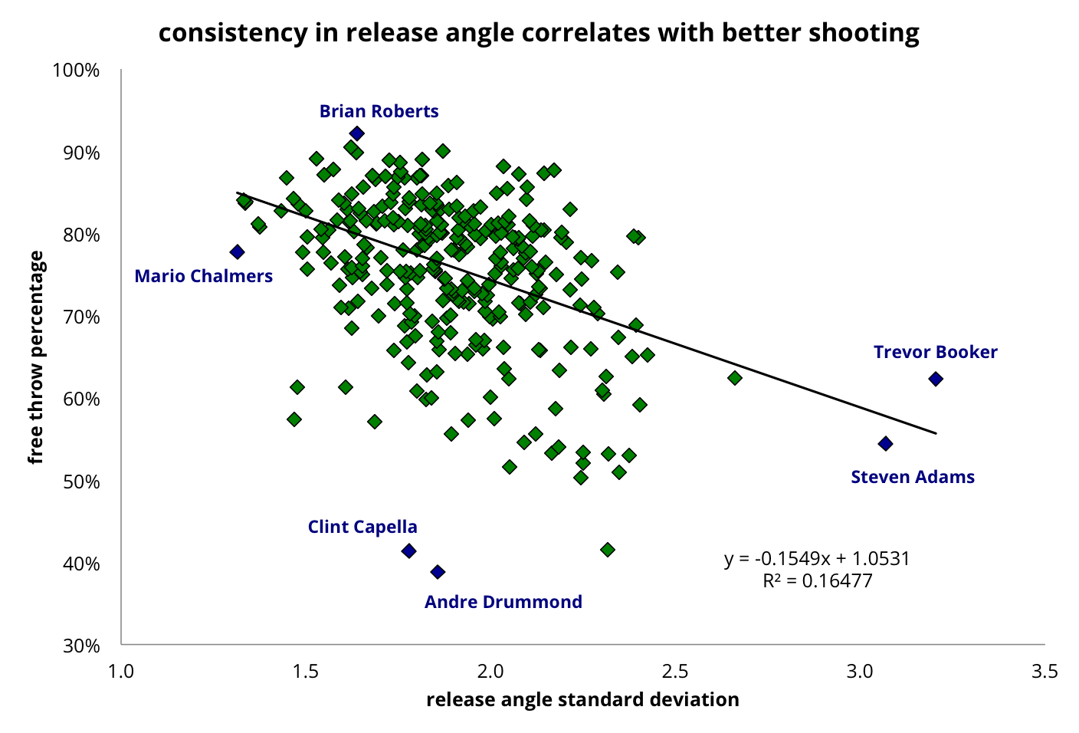
Shot Arcs!
The arcs of a player’s contested shots are generally different than those of open shots
More consistent releasing angle → Higher %
Source: inpredictable.com

Slide 4
Methodology
Find the following properties of every 3-pt shot:
Shooter
Nearest Defender
Release angle
Contested or open
Find how each shooter performs when open vs. contested
Find the average Δrelease angle that each defender makes on a shot

Slide 5
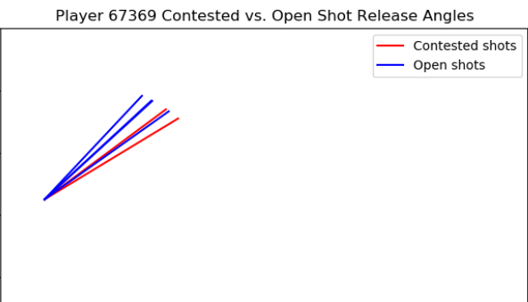
Findings: inconsistent Shooter
Open mean = 51.6
Contested mean = 43.5
Difference score = 0.322

Slide 6
Findings: Consistent Shooter
Open mean = 44.53
Contested mean = 44.51
Difference score = 0.00014

Slide 7
Findings: defender
Player 78845: Impactful defender
Average Δrelease angle = 12.7
Player 79832: Unimpactful defender
Average Δrelease angle = 3.48

Slide 8
How contested?
Threshold = 6 feet:
Average difference score = 0.135
Threshold = 5 feet:
Average difference score= 0.191

Slide 9
Prediction using linear regression
Given a pair of offensive and defensive players, predict Δrelease angle
Eg. Shooter difference score = 0.15, defender average Δrelease angle = 9.2 →
Δrelease angle = 11.8

Slide 10
Impact
Most matchups in March Madness are the 1st times two teams play each other
Teams
Assign the optimal player matchups
Offense: Find the combination such that the shooting consistency is the highest
Defense: Find the combination such that the defensive impact is the highest
Broadcasting
Enhance storytelling
Predict the effect of the marquee matchup before the game
Measure the effect of the matchup during and after the game

Slide 11
Future improvement
Larger datasets
Players’ physical measurements
Height, wingspan, vertical etc.

Slide 12
References
Beuoy, M. 2016. “Free Throw Deep Dives: Launch Angle.” https://www.inpredictable.com/2016/03/free-throw-deep-dives-launch-angle.html. Accessed March 5th, 2020.
Daly-Grafstein, D. and L. Bornn. 2019. “Using In-Game Shot Trajectories to Better Understand Defensive Impact in the NBA.” ArXiv.org: Retrieved March 5th, 2020, from arxiv.org/abs/1905.00822.

